Slide 1
Examples of Generator

Slide 2
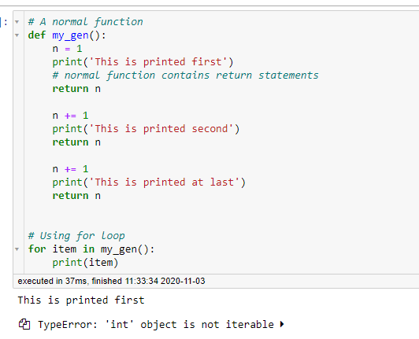
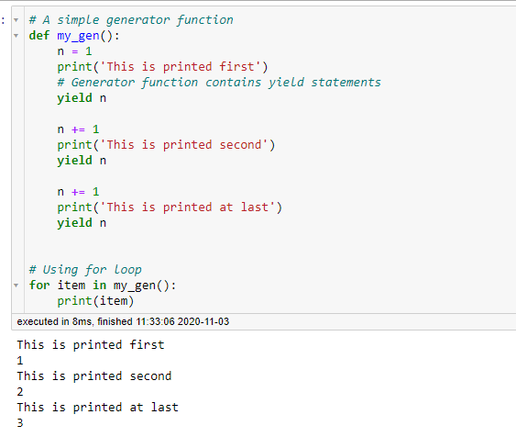
Return vs yield
Return will return the data and terminate a function immediately
But yield just pauses the function, and will continue from there in next function call
difference

Slide 3
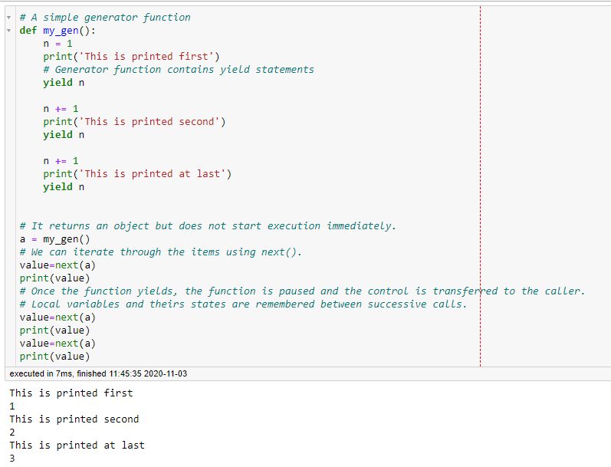
Usually we use for loop to create a generator. We can also use next() to replace for loop to continue to the next yield expression - the return data of next() is the generated value by yield statement
Automatically run the next iteration
Run the next iteration by calling next() manually
Same result

Slide 4
So far, a generator can only generate some data, can it receive data? Yes, we can use send() function
send() function can send a value to a generator
The send() method returns the next value yielded by the generator, or raises StopIteration if the generator exits without yielding another value.
When send() is called to start the generator, it must be called with None as the argument, because there is no yield expression that could receive the value.

Slide 5
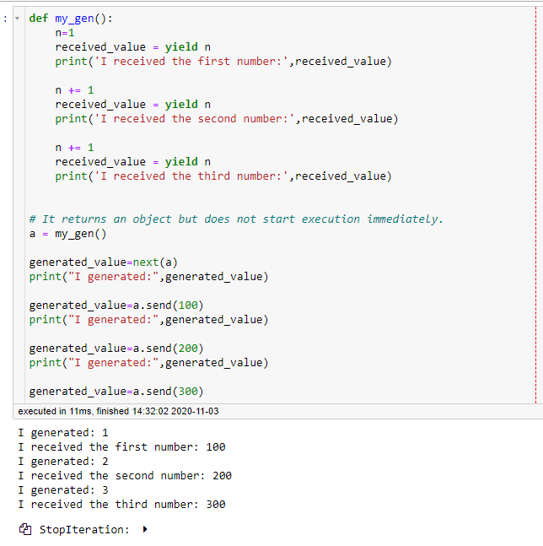
This is how we receive the data
Call next() to execute the next yield statement
The return value of send() is the generated value
The last send() causes error cause there’s no more yield
statement
Run the code in Python tutor to
See the step-by-step process https://dive4dec.github.io/optlite

